Slide 1
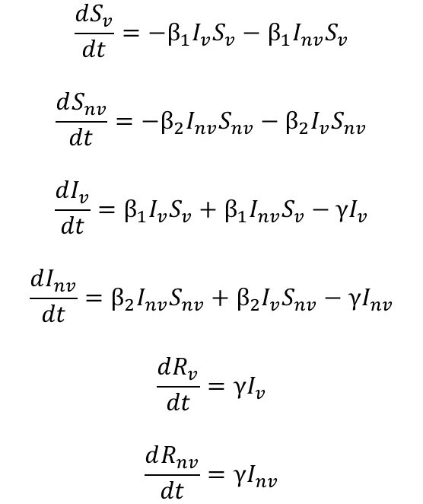
Model Equations
“Shielded”
Population
S_{v}
β₁I_{v}S_{v}
I_{v}
γI_{v}
R_{v}
$$\frac{dS_{v}}{dt}=−β_{1}I_{v}S_{v}−β_{1}I_{nv}S_{v}$$
$$\frac{dS_{nv}}{dt}=−β_{2}I_{nv}S_{nv}−β_{2}I_{v}S_{nv}$$
$$\frac{dI_{v}}{dt}=β_{1}I_{v}S_{v}+β_{1}I_{nv}S_{v}−γI_{v}$$
$$\frac{dI_{nv}}{dt}=β_{2}I_{nv}S_{nv}+β_{2}I_{v}S_{nv}−γI_{nv}$$
$$\frac{dR_{v}}{dt}=γI_{v}$$
$$\frac{dR_{nv}}{dt}=γI_{nv}$$
β₁I_{nv}S_{v}
β₂I_{v}S_{nv}
“non-Shielded”
Population
S_{nv}
I_{nv}
R_{nv}
β₂I_{nv}S_{nv}
γI_{nv}
Phase | Weeks | Beta1 | Beta2
0 | Up to I(t) = 0.0182 | 0.161 | 0.161
1 | 0-6 | 0.064 | 0.064
2 | 6-30 | 0.064/0.032/0 | 0.161
3 | 30 onwards | 0.161 | 0.161
4 | If phase 3 ends | 0.258 | 0.258
Phase | Weeks | Beta1 | Beta2
0 | Up to I(t) = 0.0182 | 0.161 | 0.161
1 | 0-6 | 0.097 | 0.097
2 | 6-30 | 0.097/0.049/0 | 0.161
3 | 30 onwards | 0.161 | 0.161
4 | If phase 3 ends | 0.258 | 0.258
BASELINE
RWC
Initial Conditions
Sv | Snv | Iv | Inv | Rv | Rnv
0.2 | 0.7999 | 0 | 0.0001 | 0 | 0
Equivalent to R0 = 2.4 -> 1.5 -> 0.6/0.3/0 -> 2.4

Slide 2
SIR Model
Repeat the sensitivity analysis with RWC scenario parameters – and the 2 other scenarios (0.049 and 0).
Sensitivity analysis comparing
Baseline SIR scenario with beta2 in phase 3 at full effect for 24 weeks
beta2 in Phase 3 tapered from no effect to full effect after 12 weeks + full effect for next 12 weeks
beta2 in Phase 3 tapered to full effect at 24 weeks

Slide 3
ONLY RWC Comparison (0.097, 0.049, 0) for Beta1 Phase 2

Slide 4
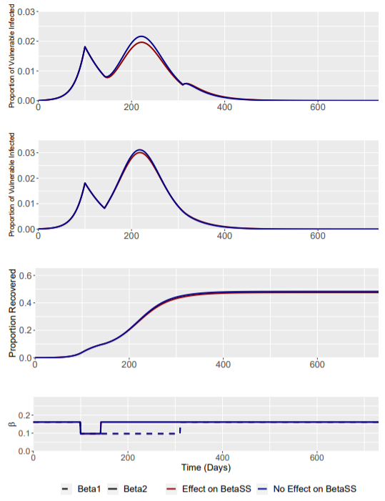
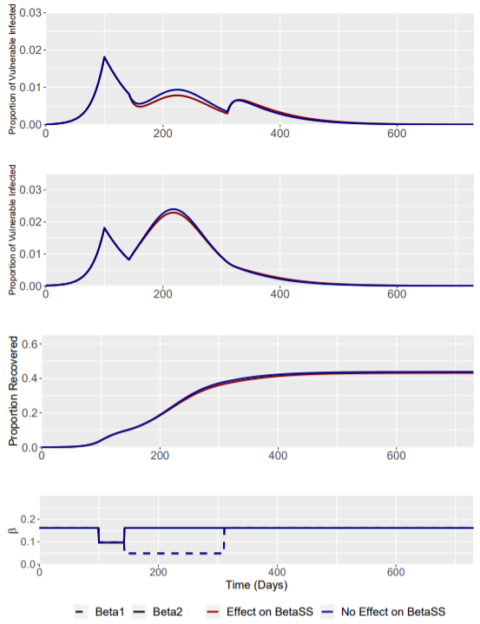
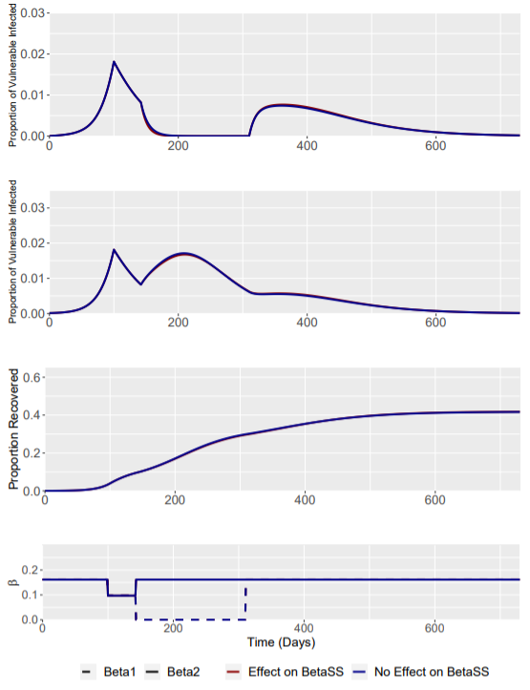
No Effect of Intervention on β_{SS}
Removing the effect of the intervention on β_{SS} transmission has very little effect on the overall model transmission dynamics.
NOTE THAT SECOND ROW IS NON-VULNERABLE
RWC Phase 2 (Beta1 = 0.097)
RWC Phase 2 (Beta1 = 0.049)
RWC Phase 2 (Beta1 = 0)

Slide 5
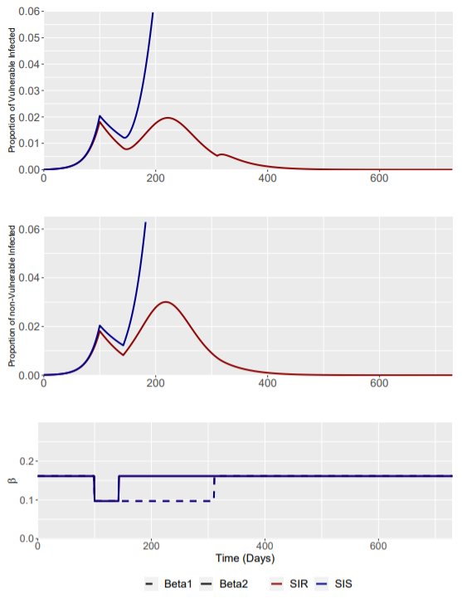
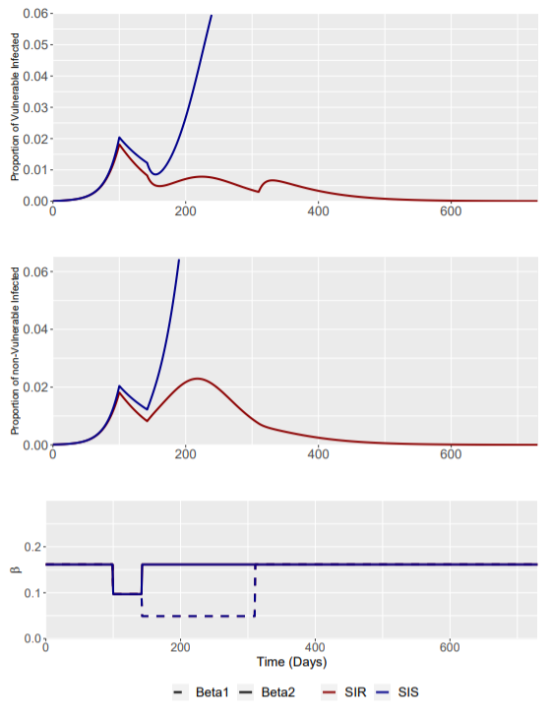
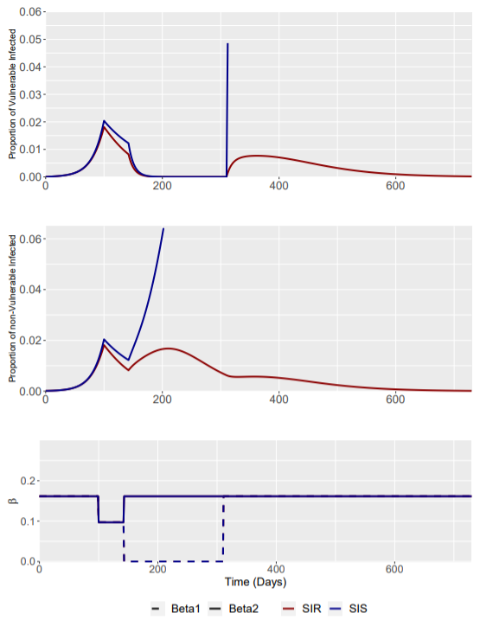
SIS vs SIR Model
The loss of immunity has significant effects on the transmission dynamics of the modelled disease.
Some figures appear to “end” early – this is because the next time point I(t) (often after intervention is released) is beyond the y-axis limits (0.06 and 0.065)
RWC Phase 2 (Beta1 = 0.097)
RWC Phase 2 (Beta1 = 0.049)
RWC Phase 2 (Beta1 = 0)

Slide 6
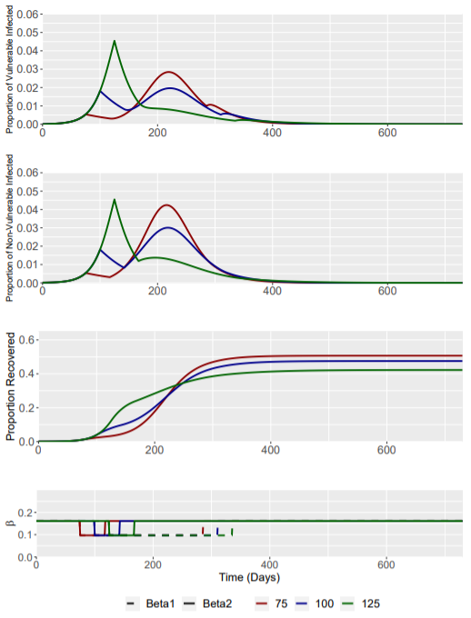
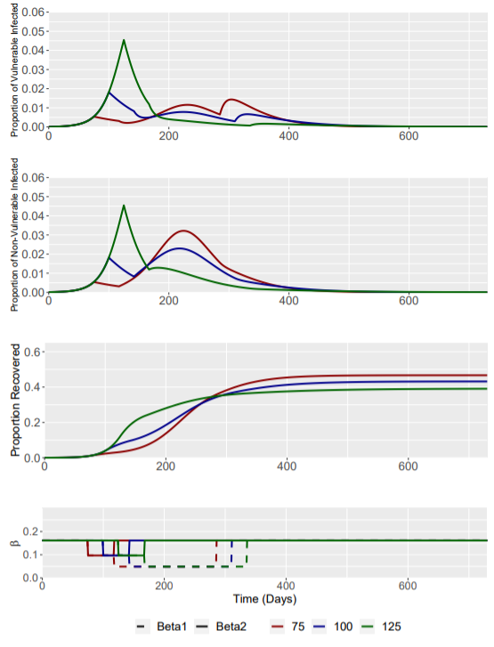
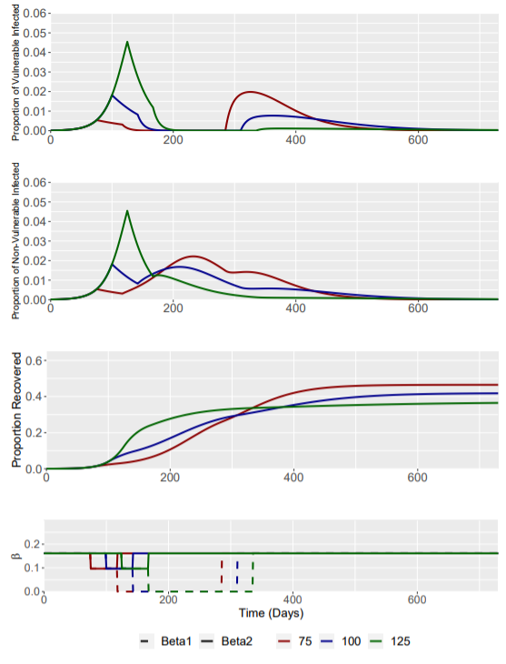
Different Intervention Triggers – I(t) = 0.0054 (day 75), 0.0182 (day 100) and 0.0454 (day 125)
RWC Phase 2 (Beta1 = 0.097)
RWC Phase 2 (Beta1 = 0.049)
RWC Phase 2 (Beta1 = 0)

Slide 7
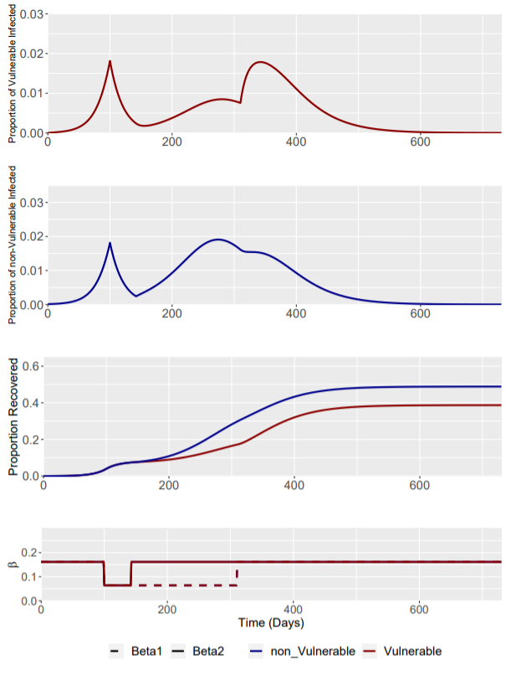
Baseline Scenario: Phase 2 β1 = 0.064
Phase | Weeks | Beta1 | Beta2
0 | Up to I(t) = 0.0182 | 0.161 | 0.161
1 | 0-6 | 0.064 | 0.064
2 | 6-30 | 0.064 | 0.161
3 | 30 onwards | 0.161 | 0.161
β1 remains static at 0.064 throughout the phase 1 and 2 of the intervention.
This is the baseline model for the enhanced shielding intervention.
Intervention trigger is at I(t) = 0.0182

Slide 8
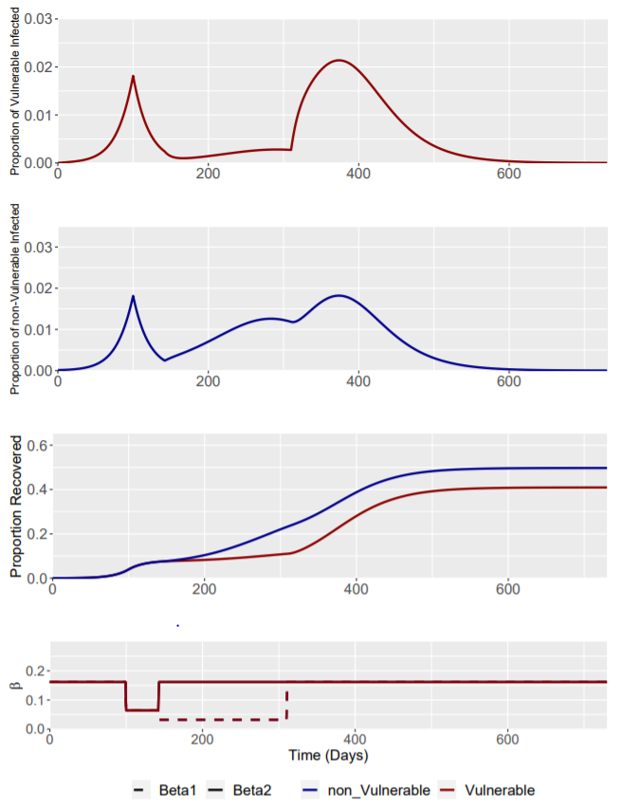
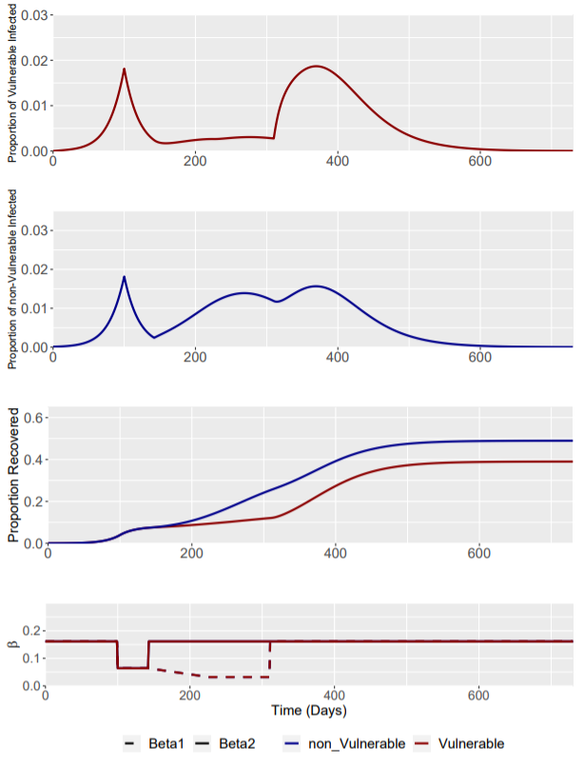
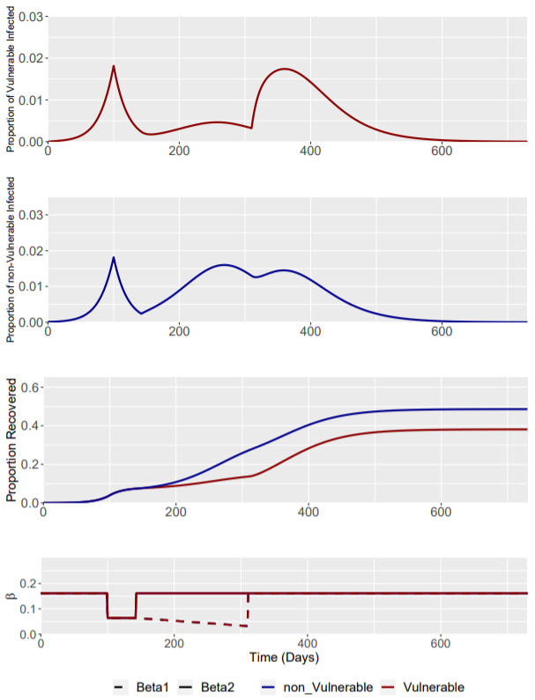
Scenario: Phase 2 β1 = 0.032
Phase | Weeks | Beta1 | Beta2
0 | Up to I(t) = 0.0182 | 0.161 | 0.161
1 | 0-6 | 0.064 | 0.064
2 | 6-30 | 0.032 | 0.161
3 | 30 onwards | 0.161 | 0.161
3 Phase 2 interventions are explored:
Constant Phase 2 β1 intervention at 0.032 for 24 weeks
“Ramp-up” 1 Phase 2 intervention with β1 linearly reduced to 0.032 by week 12 and remaining static at 0.032 for the remaining 12 weeks of phase 2
“Ramp-up” 2 Phase 2 intervention linearly reducing β1 to 0.032 throughout the 24 week intervention, reaching 0.032 at week 24
Phase 2: Constant
Phase 2: “Ramp up” 1
Phase 2: “Ramp up” 2

Slide 9
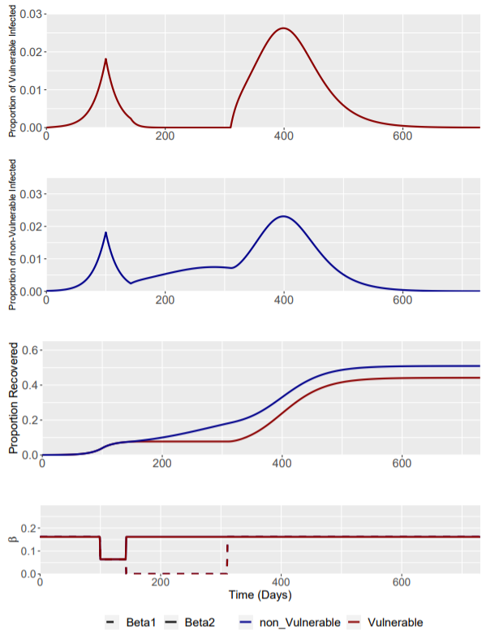
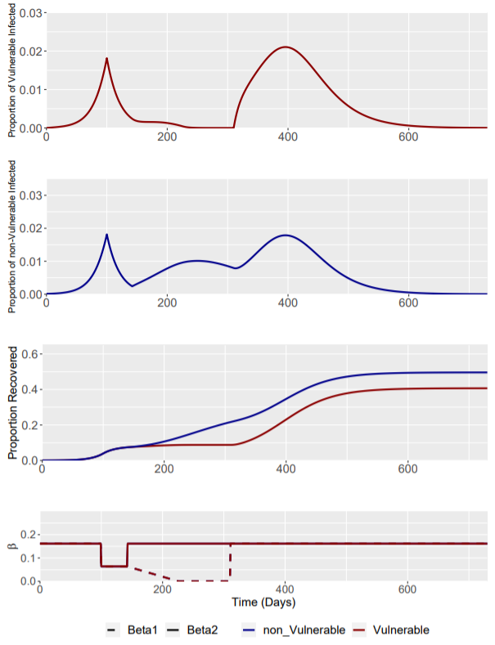
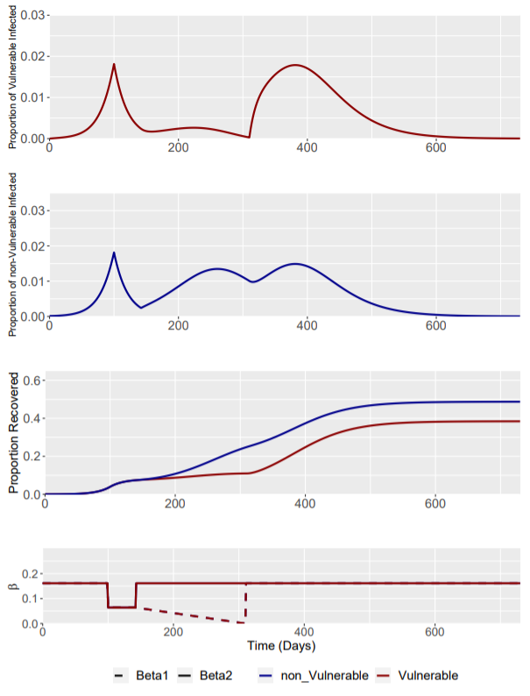
Scenario: Phase 2 β1 = 0
Phase | Weeks | Beta1 | Beta2
0 | Up to I(t) = 0.0182 | 0.161 | 0.161
1 | 0-6 | 0.064 | 0.064
2 | 6-30 | 0 | 0.161
3 | 30 onwards | 0.161 | 0.161
3 Phase 2 interventions are explored:
Constant Phase 2 β1 intervention at 0 for 24 weeks
“Ramp-up” 1 Phase 2 intervention with β1 linearly reduced to 0.032 by week 12 and remaining static at 0 for the remaining 12 weeks of phase 2
“Ramp-up” 2 Phase 2 intervention linearly reducing β1 to 0.032 throughout the 24 week intervention, reaching 0 at week 24
Phase 2: Constant
Phase 2: “Ramp up” 1
Phase 2: “Ramp up” 2

